Slide 1

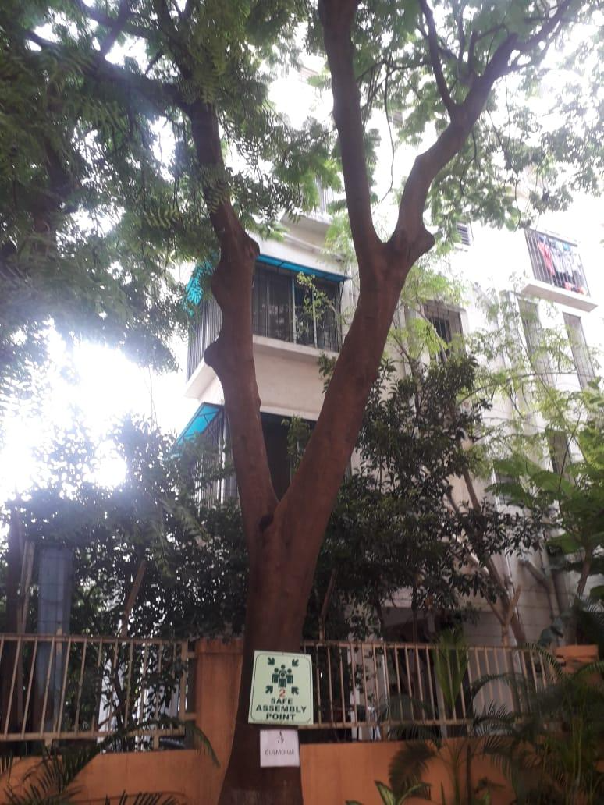

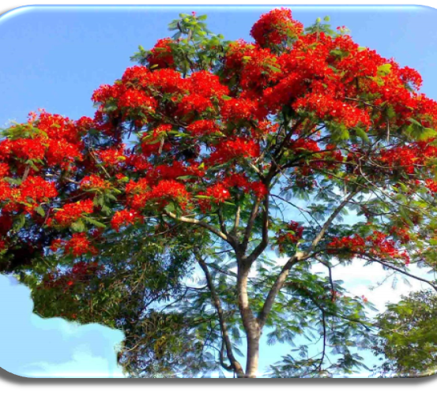
Gulmohar TREE
Near assembly point 3 to assembly point 2 and upto new bld. construction AIS Campus, Wakad.

Slide 2
Common Name : Gulmohar
Scientific Name : Delonix Regia
Family : Fabaceae.
Habit : Gulmohar tree is a large deciduous, flowering tree. It is found in tropical
and subtropical regions of the world. It is planted in parks and gardens for
its flowers.
Distribution : It is found in India, Myanmar, Thailand, Indonesia, Malaysia,
Brazil, Paraguay, USA, Mexico, South Africa, Malawi, Madagascar and
Zimbabwe.

Slide 3
Description :
Height of Tree : 5 – 12 m (18 - 40 ft).
Leaves : The leaves are light, bright green and have a feathery appearance 30-50 cm (12–20 in) long,
Flower: The flowers bloom in shades of fiery red, pink and orange. It flowers in April and in October
Fruits: Fruit pods are young and flaccid when young, and then turn brown and woody as they mature.
They can be upto 60 cm (24 in) long and 5 cm (2 in) wide.
Bark of the tree : Is light brown in colour
Seeds : Seeds are small, they weigh 0.4 grams on an average.

Slide 4
Flowers: Water extracts of flowers was used as healthy beverages in several African countries. It was also part of their local medicines and traditional biproducts.
Leaves: An essential oil obtained from Gulmohar tree’s leaves contains anti-fungal properties. Leaves also have anti-diabetic properties, using its methanol extract significantly reduces blood-glucose levels.
Seeds: Ethanolic extracts of seeds have anti-inflammatory properties.
Anti-microbial, Anti-diarrhea, Hepatoprotective, are some more medical properties of the Gulmohar tree.

